Slide 1
Chapter 1
Context

Slide 2
Terminology
Systems
Information systems (IS)
Formalised information systems
Computer-based information systems
Information technology (IT) vs IS

Slide 3
Example information systems
Payroll
Electronic auction house
Others …

Slide 4
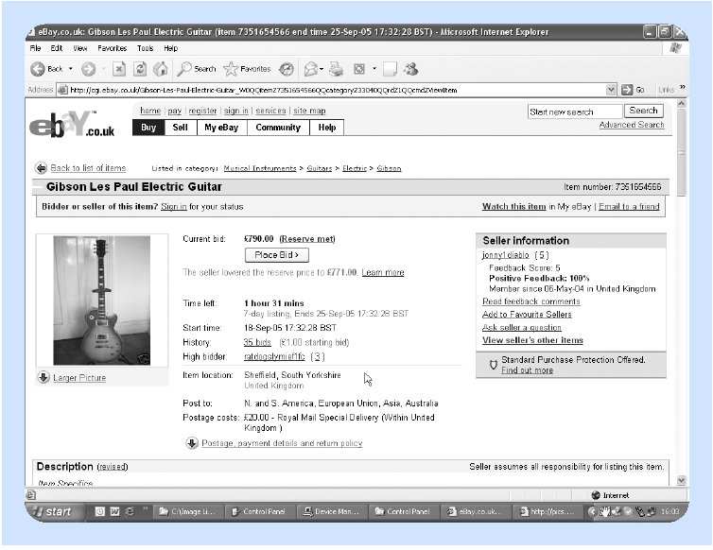
Electronic auction house (e-Bay)

Slide 5
Environment and context
Global economy
Digital economy
Electronic commerce
Non-commercial impacts
Change
Human dimension

Slide 6
Stakeholders (IS/IT)
Programmers
Systems analysts
Business analysts
Project managers
Senior IT management
Chief information officer (CIO)

Slide 7
Other stakeholders
End users and business users
  regular user, occasional or casual user
Business management
Business strategy management
Customers or potential customers
Information users
Trusted external users
Shareholders, other owners or sponsors
Society

Slide 8
Organisational aspects
Information systems strategy group
Steering committee
Systems development team
Project team leader

Slide 9
Professional aspects (the eight-point BCS code)
Professional responsibility
Law
Conduct
Approach
Management
Independence and statement of interests
Professional development
Public awareness

